Slide 1
The Original Sinnens
Still the finest architects money can hire
The original solution to the parallel scheduling problem: Progress report
Team 5

Slide 2
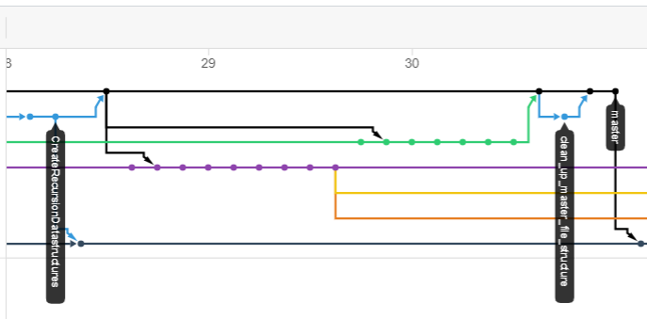
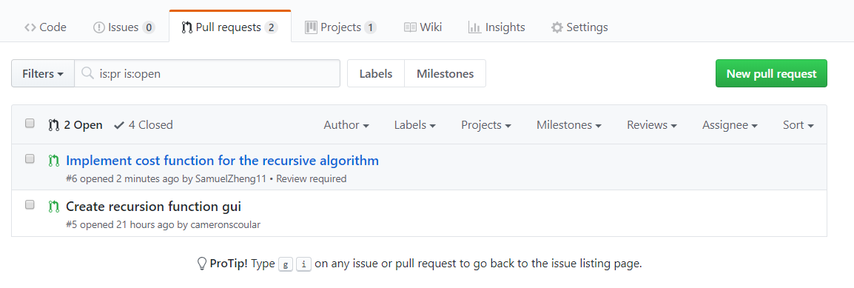
Progress and Integration

Slide 3
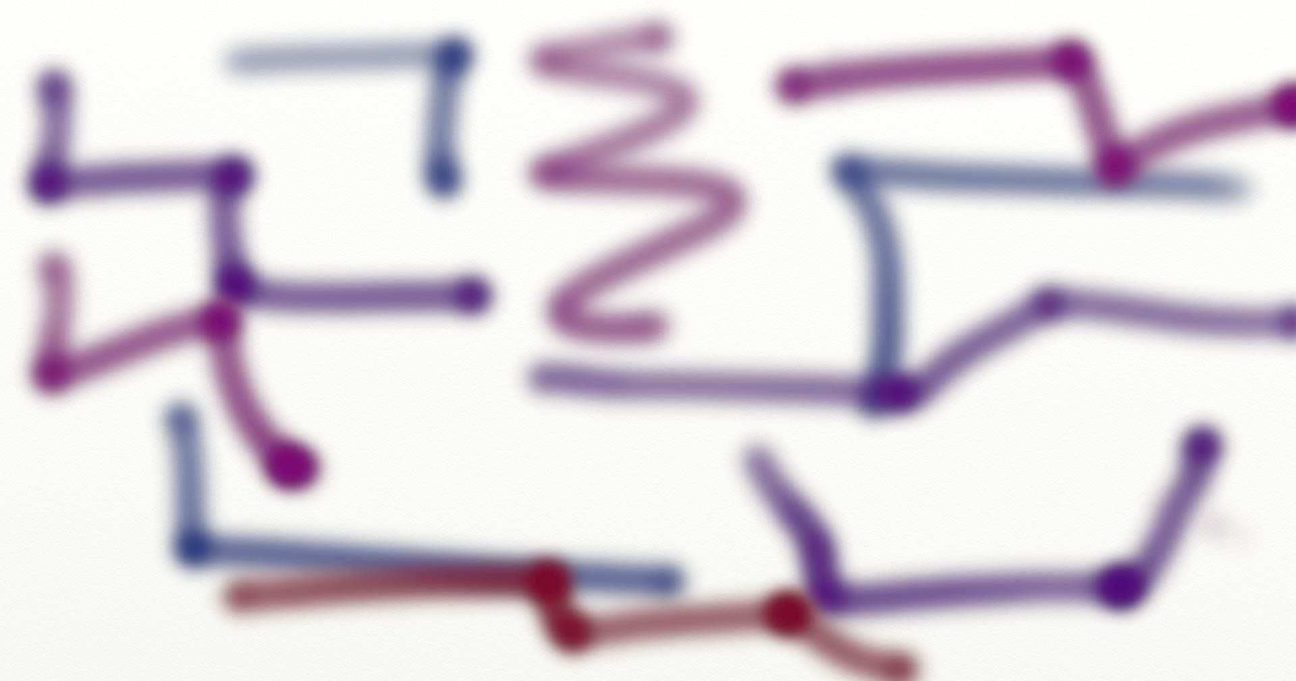
Cost function (Sam)
When to schedule a task on a processor ?
High complexity
Testing
Constant communication with algorithm implementer (Alex)
Pull request approvals

Slide 4
Recursion (Alex)
What data structures will it use
What functions?
Writing the recursion itself

Slide 5
Input/Output (Edwar)
Input reading
DOT file parsing
Proof of concept

Slide 6
Algorithm processing (Andrew)
New state created by scheduling a task
Task must be ‘free’ to be scheduled
Based on graph dependencies
Free tasks to be updated with each new state

Slide 7
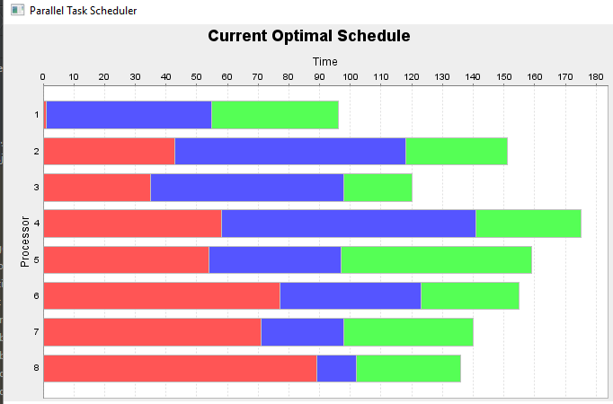
Graphical User interface & representation (Cameron)
Visualisation of optimal schedule using Gantt chart
Statistics to be implemented
JFreeChart used, currently mocked

Slide 8
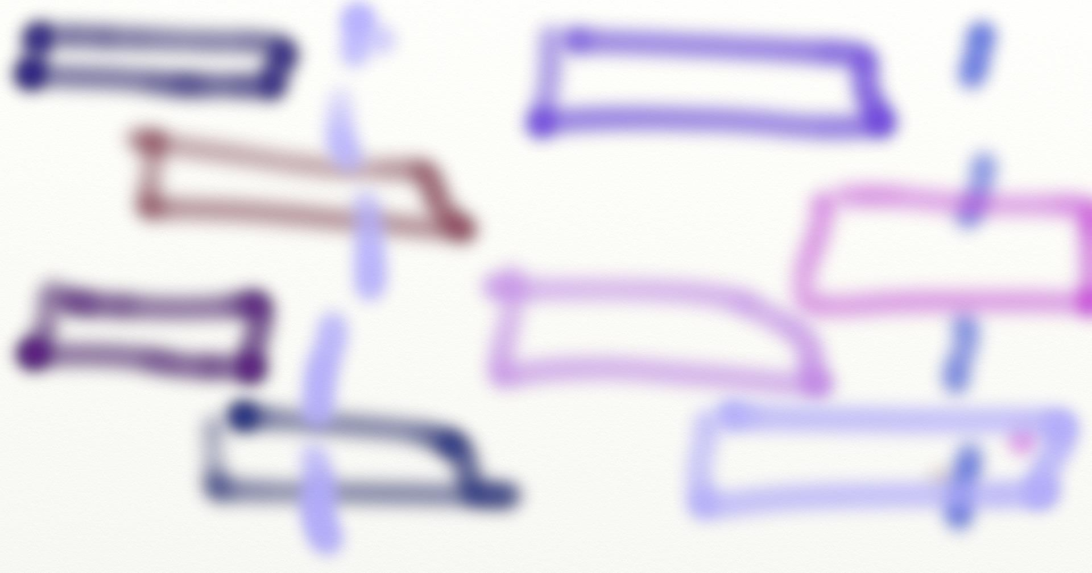
Next steps
Pre - processing
Post - processing (if needed)
Integration testing

